Slide 1

AI-Powered Healthcare Assistant
Transforming preliminary health assessment through intelligent symptom analysis and evidence-based medicine recommendations

Slide 2

The Healthcare Access Challenge
Immediate Barriers
Patient Impact
Limited access to healthcare professionals
Anxiety from unknown symptoms
Long waiting times for appointments
Delayed medical intervention
Unnecessary emergency visits
Rural and underserved areas face greater challenges

Slide 3

Market Opportunity
£180B
67%
40%
Global Digital Health Market
Patient Preference
Reduction Potential
Projected value by 2025
Want digital health tools for initial assessment
Decrease in unnecessary clinical visits

Slide 4
Our AI Solution Overview
Symptom Analysis
Disease Prediction
Machine learning algorithms process user-reported symptoms with clinical accuracy
Evidence-based predictions using comprehensive medical databases and pattern recognition
Medicine Recommendations
Professional Guidance
Safe, over-the-counter options with clear dosage guidelines and contraindications
Always directs users to qualified healthcare professionals for proper diagnosis

Slide 5
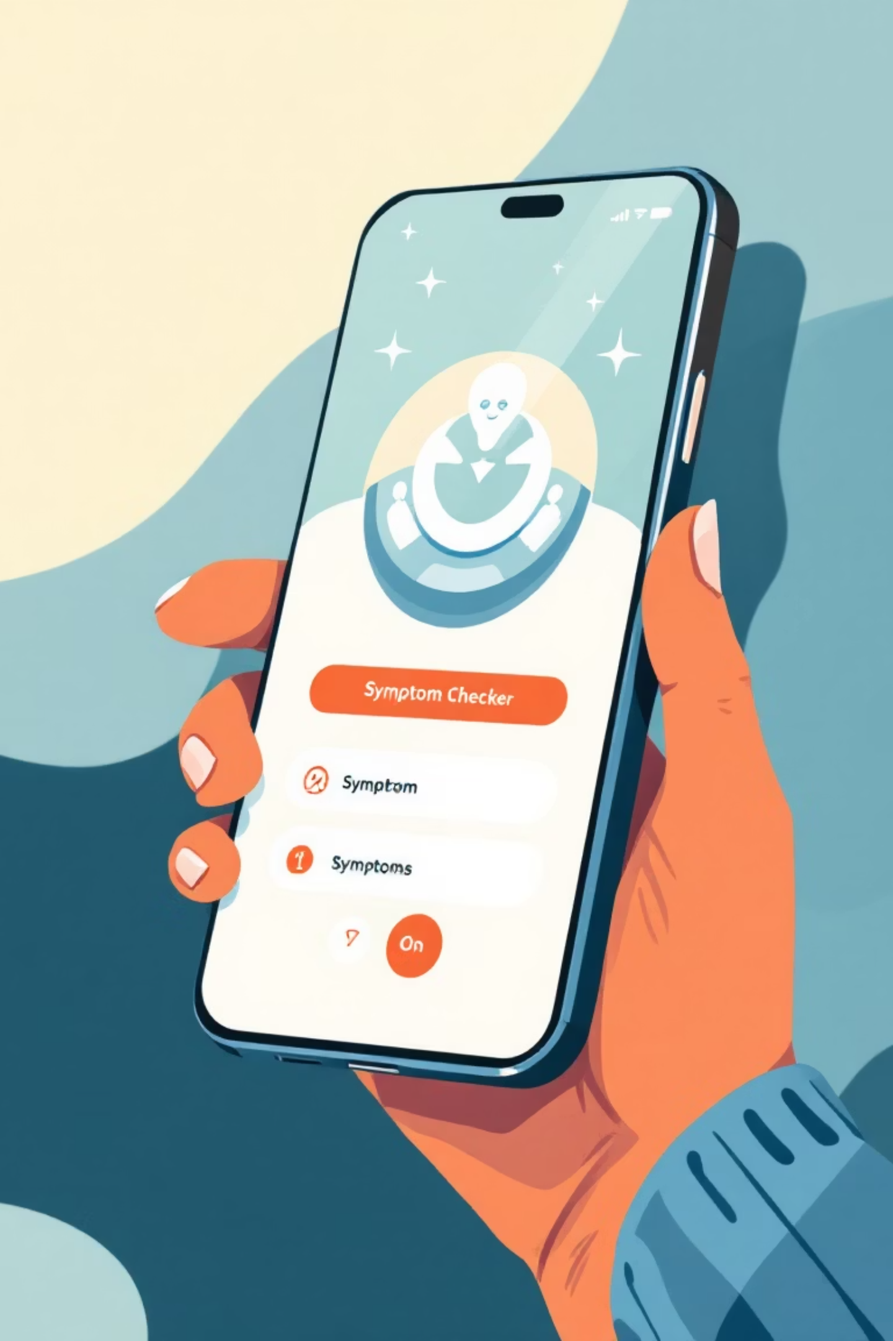




How It Works
Symptom Input
User describes symptoms through intuitive interface
AI Analysis
Machine learning algorithms process data against medical knowledge base
Predictions
System provides probable conditions with confidence levels
Recommendations
Safe medication options with professional consultation advice

Slide 6



Key Benefits
Immediate Accessibility
Cost Efficiency
Safety First
24/7 availability reduces anxiety and provides instant preliminary guidance, particularly valuable during out-of-hours periods when medical professionals aren't readily available
Reduces unnecessary clinical visits whilst ensuring appropriate cases receive professional attention, optimising healthcare resource allocation
Built-in safeguards ensure responsible use with mandatory professional consultation recommendations for all significant health concerns

Slide 7

Business Opportunities
Healthcare Providers
Insurance & Pharma
Hospitals and clinic networks
Health insurance companies
Telehealth platforms integration
Pharmaceutical partnerships
Employee health benefits
Corporate wellness programmes
TCS can integrate this solution into existing healthcare portfolios, creating new revenue streams whilst strengthening client relationships

Slide 8








Scalability & Global Reach
Geographic Adaptation
Multi-Language Support
Localised datasets for different regions and demographics
Expandable to support multiple languages and cultural contexts
IoT Integration
Cloud Infrastructure
Compatible with wearables and health tracking devices
Scalable deployment for millions of users across regions

Slide 9

Risk Management
Prediction Accuracy
User Behaviour
Continuous model refinement with medical expert validation ensures reliable results whilst clearly communicating confidence levels to users
Built-in safeguards prevent over-reliance through mandatory professional consultation prompts for all significant health concerns
Data Quality
Diverse, balanced datasets prevent algorithmic bias whilst ensuring representative coverage across demographics and conditions

Slide 10
Next Steps
01
02
Pilot Development
Clinical Validation
Build MVP with core symptom analysis and medicine recommendation features
Partner with healthcare professionals to validate accuracy and safety protocols
03
04
Regulatory Compliance
Market Launch
Ensure adherence to healthcare regulations and data protection standards
Deploy with key healthcare partners and begin scaling across TCS client base
Transforming healthcare accessibility through responsible AI innovation

Slide 11
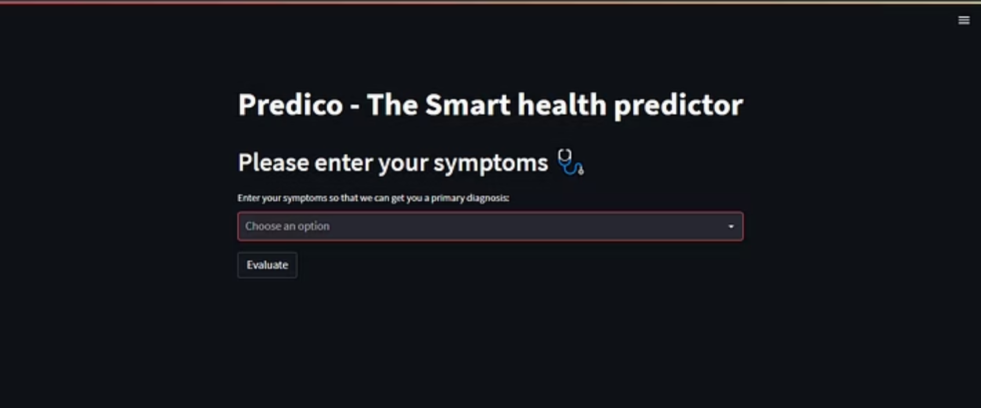
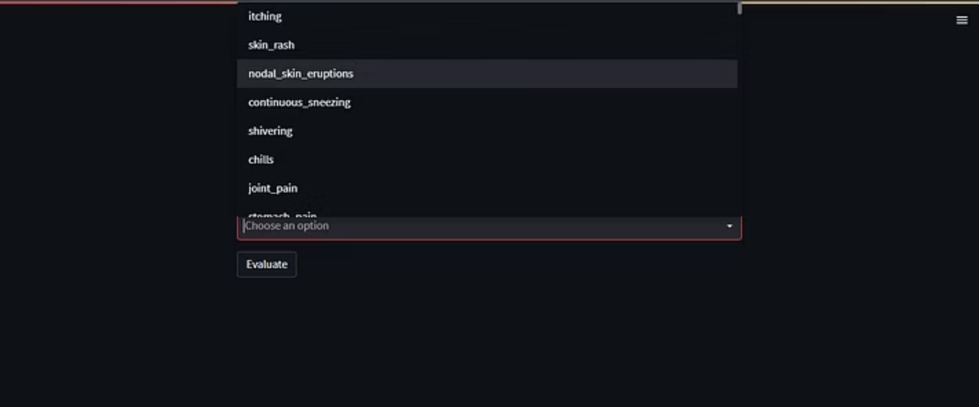

Prototype Screenshots

Slide 12

Thank You
Thank you for your time and attention today.
We welcome your questions and look forward to a productive discussion.

